Slide 1
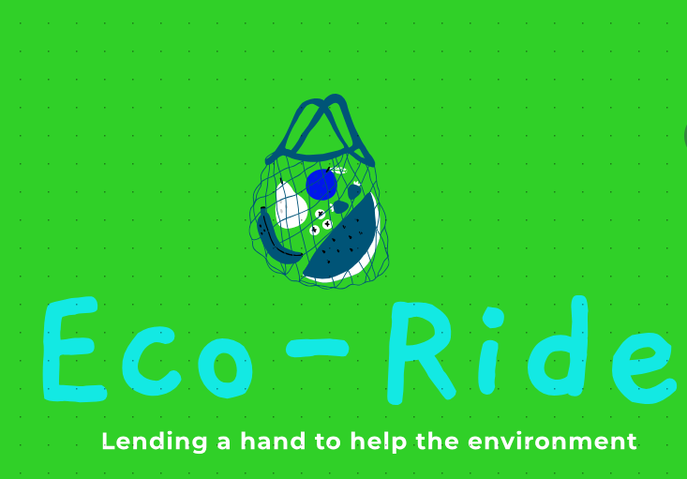
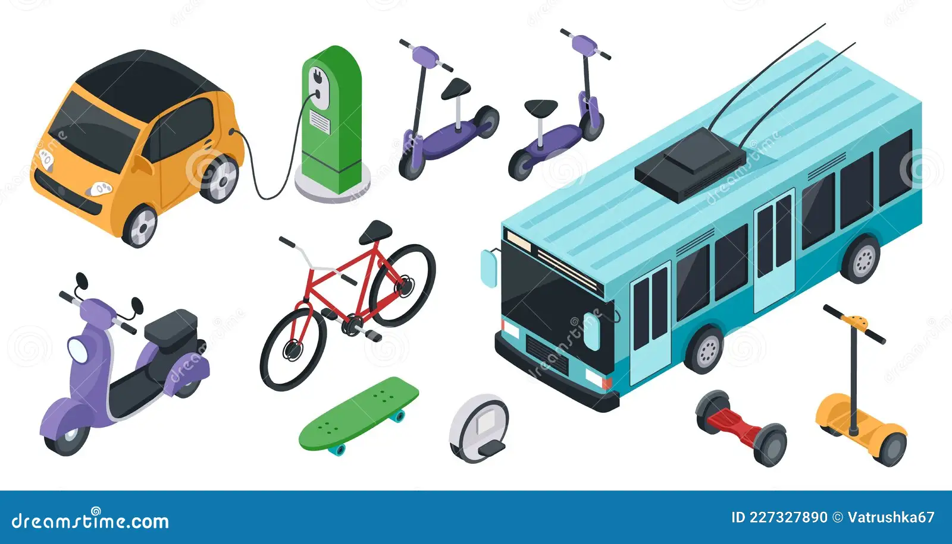
Team - Columbans
OUT OF THE 3.4 MILLION TONNES OF PLASTIC WASTE PRODUCED IN INDIA,
ONLY 30% OF IT ACTUALLY GETS RECYLED….
TO HELP RECYCLE THE REMAINING 70% WE HAVE FOUNDED OUR COMPANY
THE PROBLEM STATEMENT
Develop A web/ mobile application that inputs the amount of waste material and calculates its corresponding price. This solution should also accomodate the specification of material type, such as paper or plastic, adjusting the valuation accordingly. this user frendly app streamlines waste management transactions by providing accurate pricing based on quality and material composition.

Slide 2
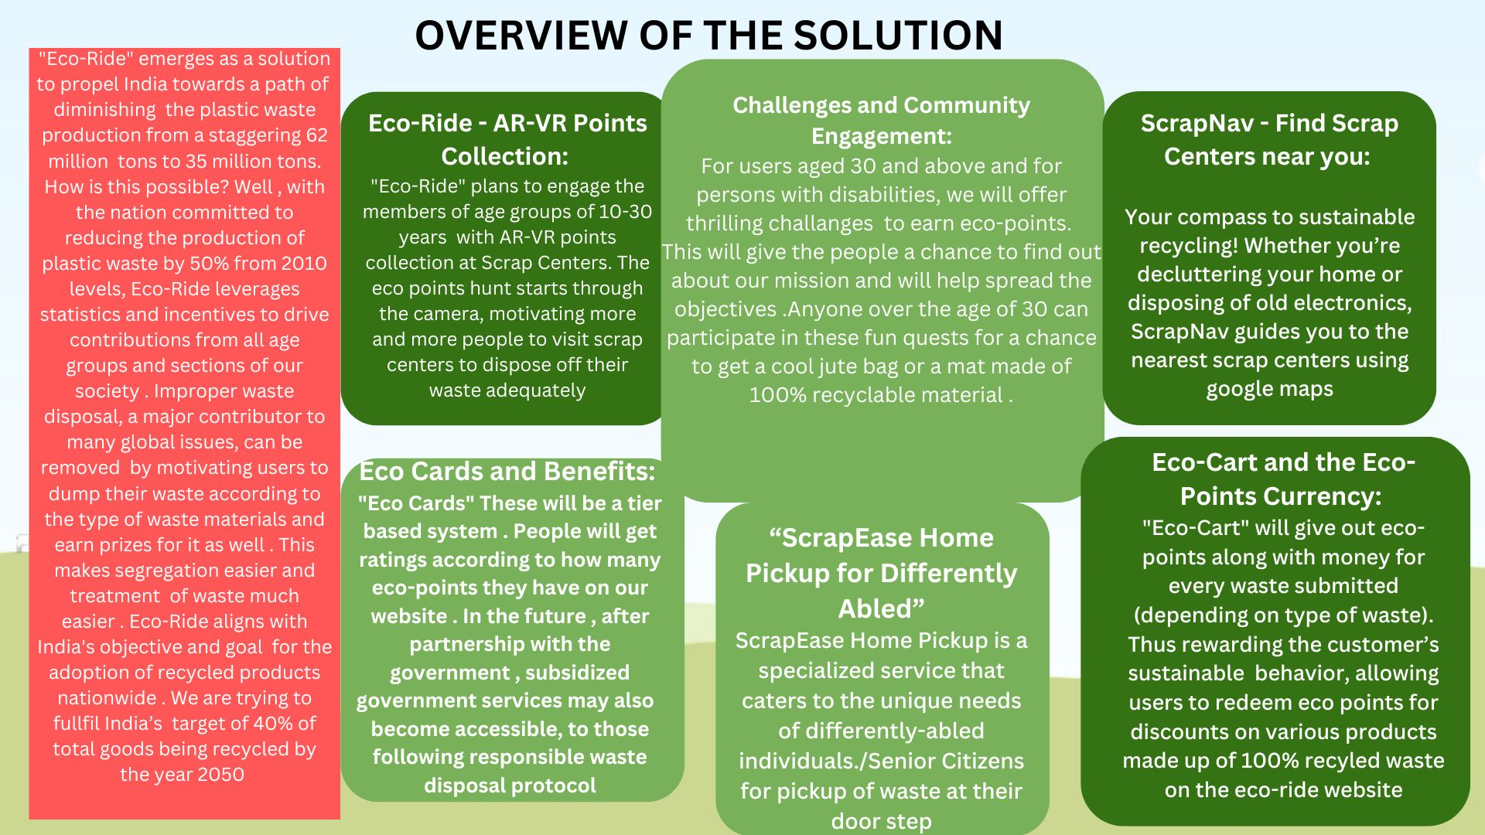

Slide 3


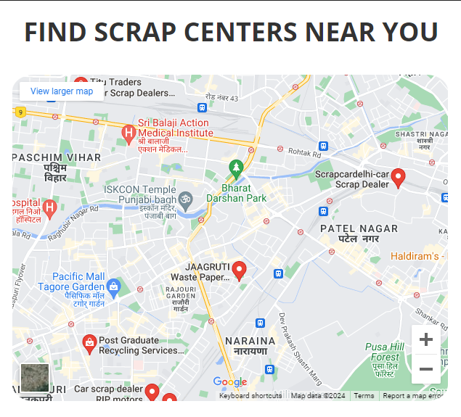
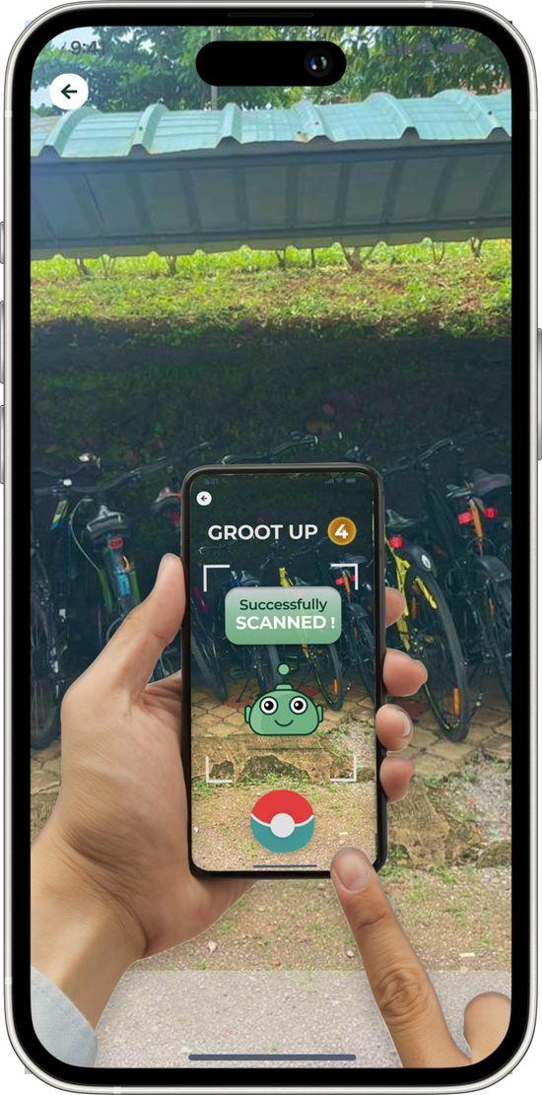
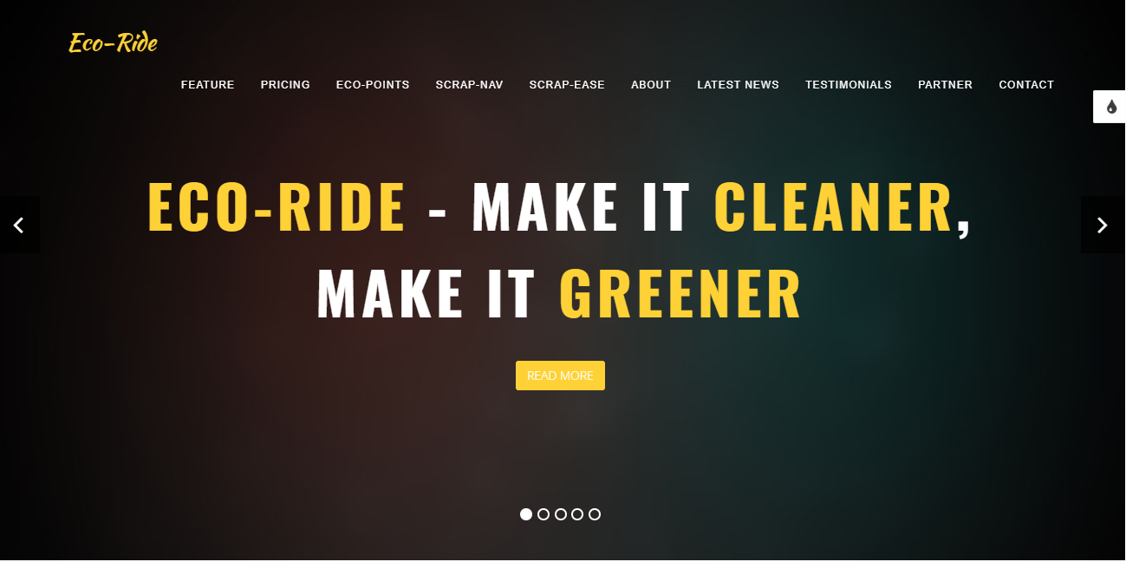
UI/UX Screens

Slide 4
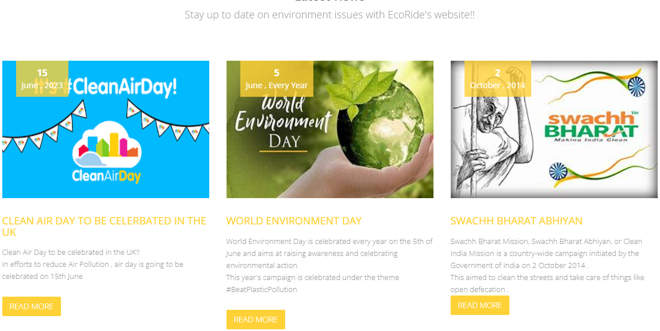
UI/UX Screens

Slide 5
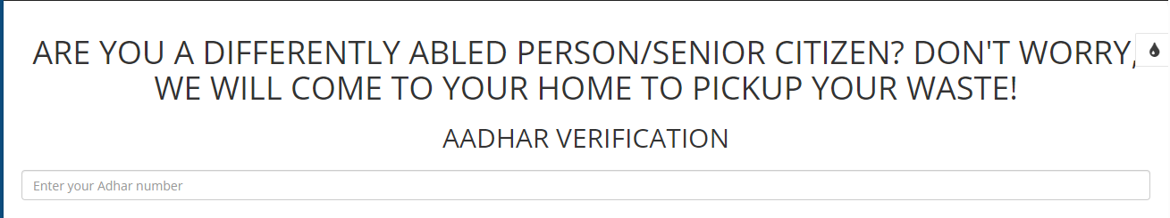
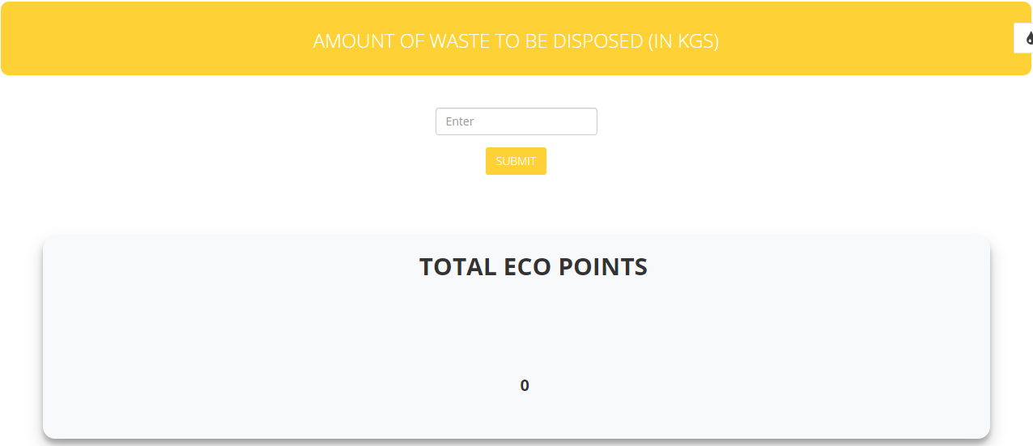
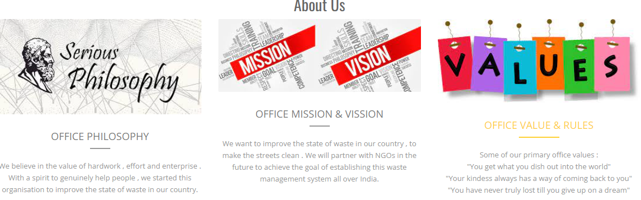
UI/UX Screens

Slide 6






Business Opportunities
College Partnerships and Branded Events
Government Partnerships
Marketplace
Sponsored Challenges
Scrap Services Collaboration
Initially, to generate revenue and increase brand visibility, Eco-Ride can integrate ads from relevant brands, especially those aligned with eco-friendly values.
For example, an electric car company or a sustainable fashion brand might advertise within the app.
Potential for collaboration with governmental bodies. The app could be eligible for grants or funding from local and national government departments focused on sustainability.
Such partnerships not only offer financial support but also lend credibility to Eco-Ride, potentially leading to wider adoption and more impactful collaborations in the future.
Target users aged 15-25 through partnerships with schools, colleges, events, and student organizations..
Create brand awareness, establish a user base within the college demographic, and integrate ads from relevant eco-friendly brands.
Partner with eco-friendly brands or local businesses to sponsor challenges. For instance, a bicycle company might sponsor a "Bike to Work Week" challenge.
In return, the brand gets visibility and promotion within the app.
Partner with Scrap centers and waste management companies to promote adequate waste disposal, particularly for the differently-abled and senior citizens.
This collaboration not only supports sustainability but also aligns with the values of accessibility and environmental consciousness.
03
01
05
02
04

Slide 7
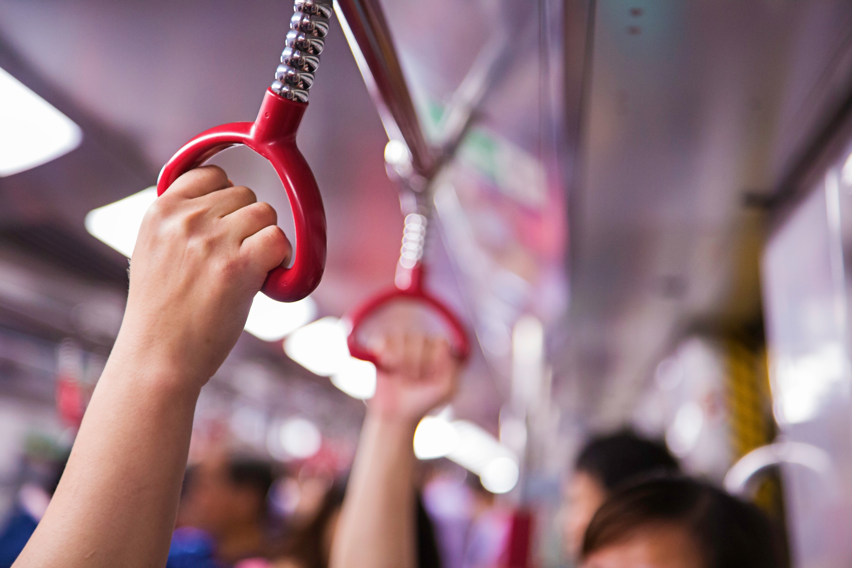
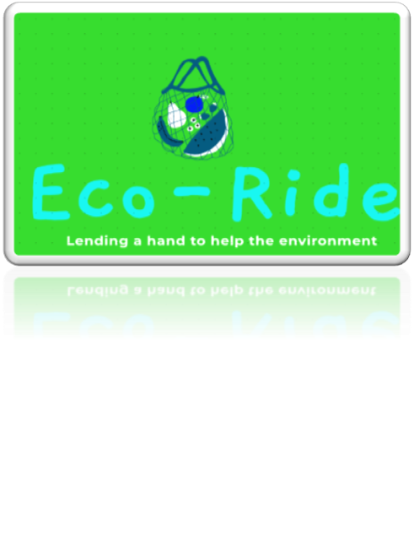


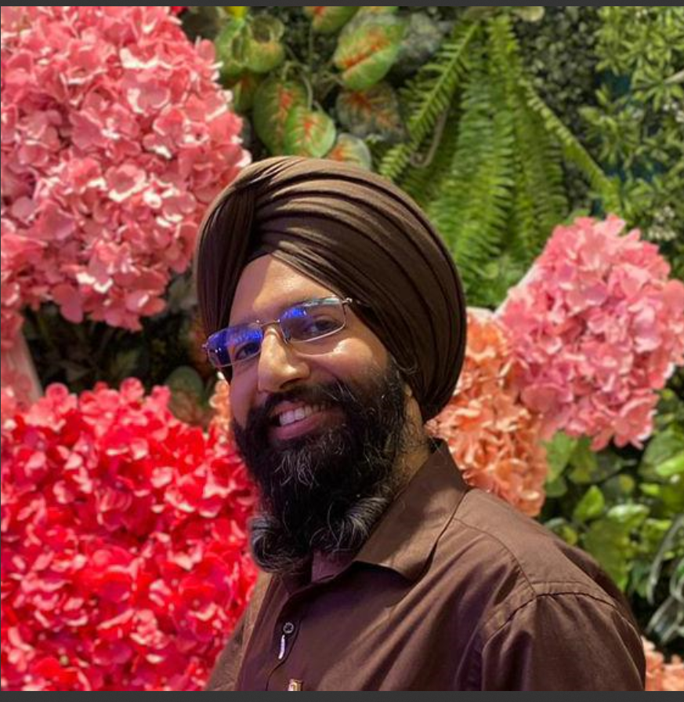
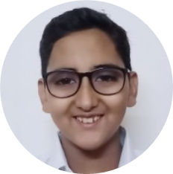
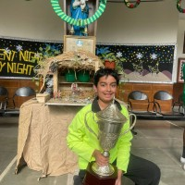
OUR MENTOR
Tejinder Singh
Yashasvi Khurana
Shankhin Sharma
THANK YOU FOR LISTENING!!

